Slide 1
Group 1

Slide 2
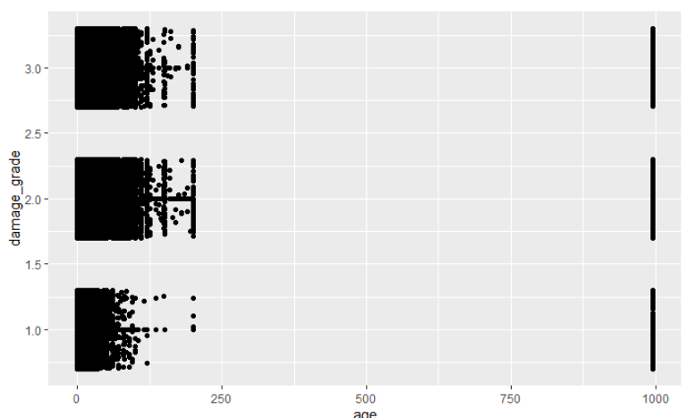
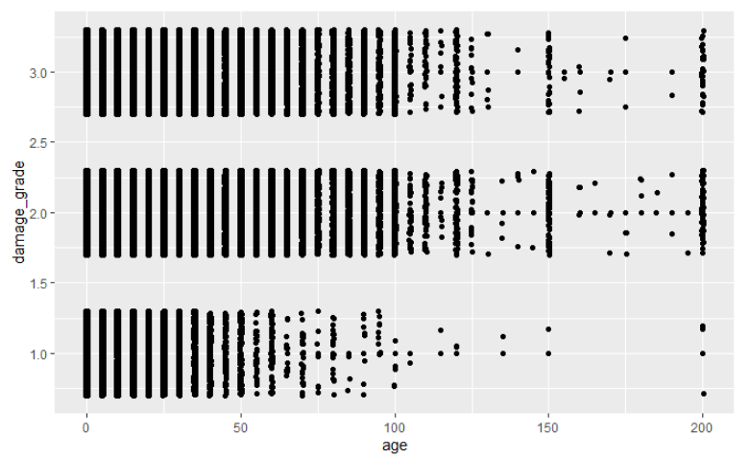
Outliers
Filter age<250

Slide 4
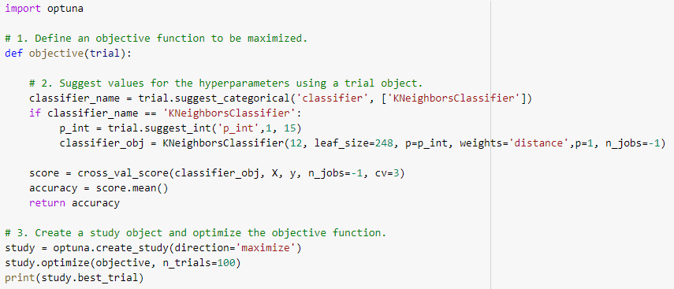
K-nearest neighbors Optimization
Attempted to use optuna
Best performance with leaf_size 30 (default), 12 neighbors, manhattan distance, weighted closer neighbors more than further neighbors
Marginal improvement from hyperparameter optimization tried last week, probably need more experience with optuna
Kaggle score 0.71867

Slide 5
Feature Selection - Backward Elim (contd)
Calculate p-values of all features
Remove the feature with the highest p-value (>0.05)
Repeat
Kaggle score dropped from 0.71867 to 0.69776

Slide 6
Feature Scaling
Imabalance in some features (age clustered around ~10, height around ~5, count_floors ~2)
Causes distanced-based algorithms (like our K-nearest neighbors!) to not perform optimally.
Used sklearn’s min-max, standard, and robust, and more!

Slide 7
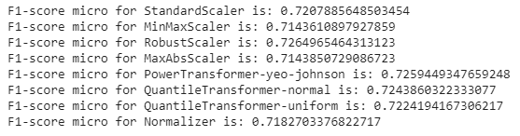
Results!
Improvement with many methods
Robust, PowerTransformer, QuantileTransformers all did well!

Slide 8
Goals for future:
Try more models!
Figure out optuna and do better hyperparameter selection
Try pytorch?

